Slide 1
Understanding BERT and GPT
Exploring Encoders, Decoders, and What Makes Them Different

Slide 2
The Foundation: What Are Transformers?
Input Text
Words converted to numerical tokens and embeddings
Transformers revolutionized natural language processing by introducing parallel processing and attention mechanisms that understand contextual relationships between words
Self-Attention
Model weighs importance of each word relative to others
Introduced in 2017 paper "Attention is All You Need" by Vaswani et al., transformers replaced recurrent neural networks
Self-attention mechanism allows the model to weigh importance of different words when processing each word
Multi-head attention runs parallel operations, each focusing on different aspects of word relationships
Position encoding injects word order information since transformers lack sequential processing
Feed-Forward
Processes representations through neural network layers
Output
Generates contextual understanding or predictions

Slide 3
Original Transformer: Encoder-Decoder Architecture
Component | Purpose | Attention Type | Use Case
Encoder | Process input sequence and create rich representations | Bidirectional (sees all words) | Understanding input context
Decoder | Generate output sequence one token at a time | Causal (only sees past words) | Text generation and translation
Cross-Attention | Decoder attends to encoder outputs | Decoder-to-encoder | Connect input and output sequences
Encoder processes entire input simultaneously creating comprehensive understanding without sequential constraints
Decoder generates output autoregressively, predicting one word at a time while attending to previous words and encoder output
Originally designed for machine translation where source language goes through encoder and target is generated by decoder
Both use stacked layers with self-attention, feed-forward networks, residual connections, and layer normalization

Slide 4
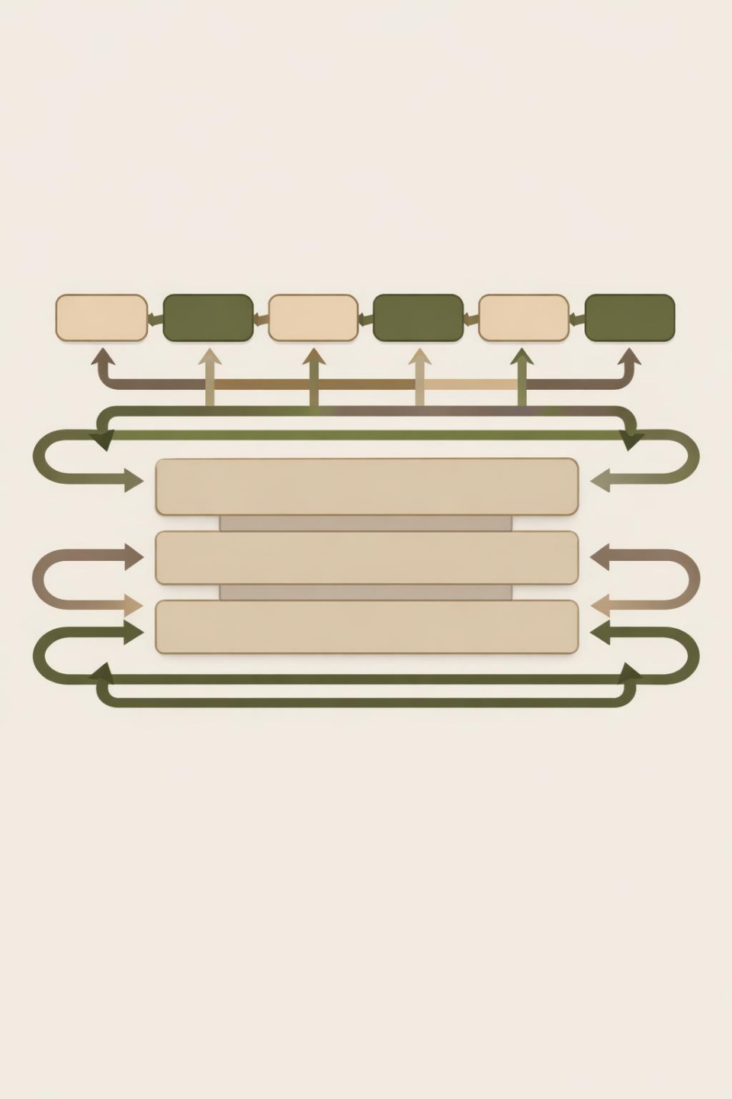
BERT: The Bidirectional Encoder Champion
Developed by Google in 2018, BERT stands for Bidirectional Encoder Representations from Transformers
Uses 12 layers in base model and 24 layers in large model, consisting entirely of stacked transformer encoders
Bidirectional training allows model to consider context from both directions when processing each word
Self-attention mechanism enables each word to see and learn from every other word in sentence simultaneously

Slide 5
Input Text
"The cat sat on the [MASK]"
How BERT Learns: Masked Language Modeling
Random Masking
15% of tokens replaced with [MASK] token
During training approximately 15% of tokens are randomly masked, forcing model to develop rich representations that capture deep relationships between words
Unlike sequential models, BERT can use words from both left and right of each masked token, creating much richer understanding than unidirectional approaches
Masked Language Modeling enables parallel processing where all positions are processed simultaneously during training making it highly efficient
Additional Next Sentence Prediction task trains BERT to understand relationships between sentence pairs for better contextual comprehension
Bidirectional Processing
Model analyzes context from both directions
Prediction
Uses left and right context to predict "mat"
Learning
Develops rich representations capturing word relationships

Slide 6
BERT's Real-World Applications
11 NLP Tasks
2018 Release
BERT set new benchmarks across diverse language tasks
Adopted by Google to improve search query understanding
Sentiment analysis and text classification leveraging bidirectional context to understand nuanced meaning and emotional tone
Question answering systems where BERT reads passages and extracts precise answers by understanding relationships
Google Search integration improves query understanding by analyzing search terms bidirectionally for more relevant results
Named Entity Recognition identifies people, places, organizations in text by understanding contextual clues from surrounding words
Semantic search and information retrieval matching user intent with relevant documents based on deep contextual understanding
Text summarization and extractive tasks where understanding full document context helps identify most important information

Slide 7
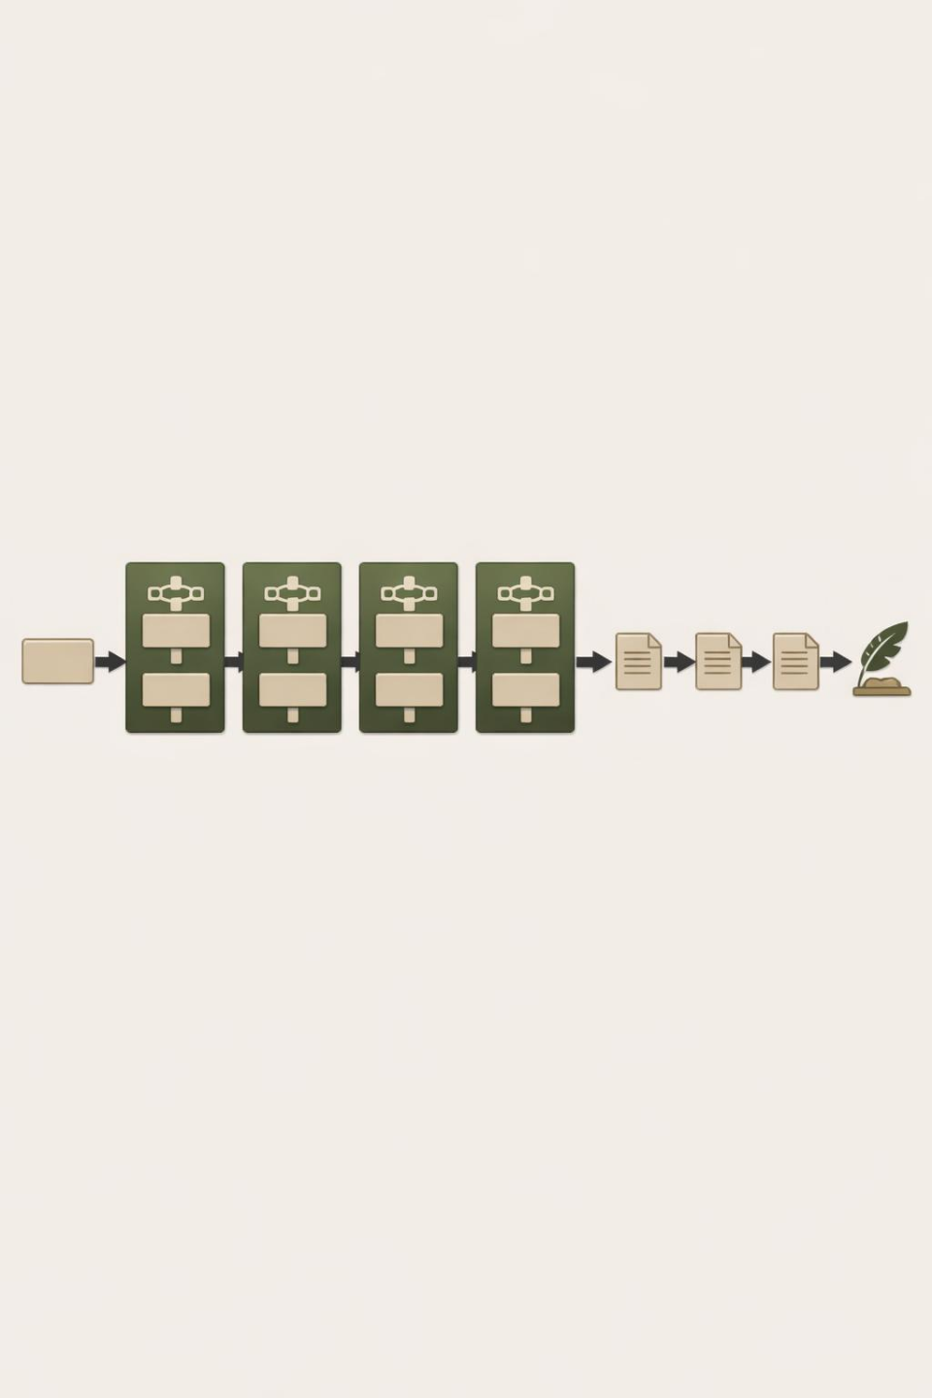
GPT: The Autoregressive Decoder Master
GPT stands for Generative Pre-trained Transformer, using language models pre-trained on large datasets to generate human-like text
Uses masked multi-head attention hiding future tokens during training, forcing GPT to look only at previous words
Autoregressive approach means each output becomes the next input in sequence, naturally learning to predict next word
Causal self-attention prevents each token from attending to future positions, maintaining temporal order essential for generation

Slide 8
How GPT Generates: Causal Language Modeling
Training uses causal language modeling where the model predicts the next word based only on past words
Each decoder block uses masked multi-head self-attention ensuring predictions depend only on previous positions
Model generates coherent text autoregressively by learning robust language patterns during pre-training

Slide 9
GPT's Real-World Applications
Creative writing and storytelling where GPT generates coherent narratives, articles, and long-form content that maintains context and logical flow
Few-shot and zero-shot learning capabilities allowing GPT to perform new tasks from just examples or instructions without task-specific fine-tuning
Conversational AI powering chatbots like ChatGPT that generate natural human-like responses in dialogue maintaining context across conversation turns
Code generation and programming assistance translating natural language descriptions into functional code across multiple programming languages
Text completion and summarization generating concise summaries or continuing partial text while maintaining stylistic and semantic consistency
Machine translation tasks generating fluent target language text though encoder-decoder models often perform better for translation

Slide 10
BERT vs GPT Architecture Comparison
Feature | BERT | GPT
Architecture | Encoder-only transformers | Decoder-only transformers
Attention Type | Bidirectional multi-head attention | Masked causal attention
Context Direction | Both left and right simultaneously | Only left (previous tokens)
Training Method | Masked Language Modeling | Causal Language Modeling
Primary Purpose | Understanding and extracting meaning | Generating coherent text
Best Use Cases | Classification, QA, NER, search | Writing, chatbots, completion
The Key Differences: BERT vs GPT
BERT processes complete sentences simultaneously seeing full context making it ideal for comprehension tasks requiring understanding of relationships
GPT generates sequences step-by-step predicting one token at a time making it naturally suited for text generation and creative tasks
Both share transformer architecture foundation with self-attention and feed-forward layers but apply them in fundamentally different ways

Slide 11
Choosing the Right Architecture
Use BERT for analyzing existing text like sentiment analysis, classification, entity extraction, or search
BERT's bidirectional nature excels when full context matters like question answering with simultaneous understanding
Pre-training on large data followed by task-specific fine-tuning achieves state-of-the-art results with small labeled datasets
Use GPT for generating new text like creative writing, dialogue systems, code generation, or completion
GPT's autoregressive training naturally aligns with generation, producing fluent coherent sequences maintaining context and style
Modern hybrid approaches combine strengths with encoder-decoder models like T5 and BART for conditional generation tasks

Slide 12
THANK YOU

